Slide 1


Slide 2

Introduction to Python AND
Python for Scientific Computing

Slide 3

Control Flow
The basic idea of control flow is that we want control of the order in which the code is executed.
In your experience with other languages, what types of statements, structures help with this?

Slide 4
Method 1: Indentation
Type the following lines in your Python interpreter, and be careful to respect the indentation depth. The Ipython shell automatically increases the indentation depth after a colon : sign; to decrease the indentation depth, go four spaces to the left with the Backspace key. Press the Enter key twice to leave the logical block.

Slide 5
Method 2: While/For loops (Iteration)
Algorithms require two important control structures: iteration and selection. Both of these are supported by Python in various forms.
While - The while statement repeats a body of code as long as a condition is true.
For - The for statement can be used to iterate over the members of a collection, so long as the collection is a sequence.

Slide 6
Method 3: If/elif/Else statement (Selection)
Selection statements allow programmers to ask questions and then, based on the result, perform different actions.
Selection constructs, as with any control construct, can be nested so that the result of one question helps decide whether to ask the next.
An alternative syntax for this type of nested selection uses the elif keyword. The else and the next if are combined so as to eliminate the need for additional nesting levels. Note that the final else is still necessary to provide the default case if all other conditions fail.

Slide 7
List Compreprehension
A list comprehension allows you to easily create a list based on some processing or selection criteria

Slide 8
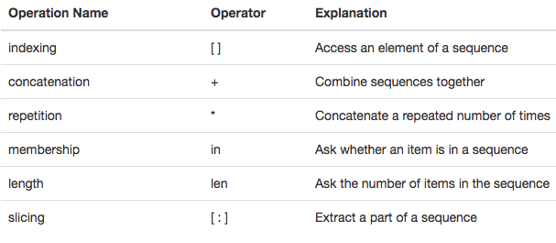
Operations on Lists

Slide 9
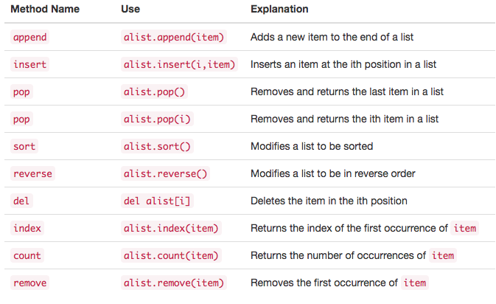
List Methods
A method is a function that “belongs to” an object

Slide 10
Strings
Strings are sequential, immutable, collections of zero or more letters, numbers and other symbols. We call these letters, numbers and other symbols characters. String values are differentiated from identifiers by using quotation marks (either single or double).
The operations on Lists and strings are exactly the same EXCEPT that strings are immutable and cannot be modified. To modify a string, the .replace() method must be used an must be set to another variable.

Slide 11
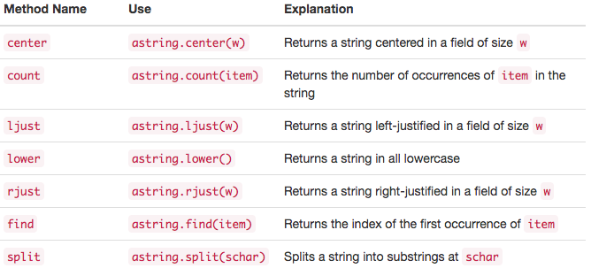
String Methods
Slide Contents

Slide 12
Tuples
Tuples are very similar to lists in that they are heterogeneous sequences of data. The difference is that a tuple is immutable, like a string. A tuple cannot be changed. Tuples are written as comma-delimited values enclosed in parentheses.

Slide 13
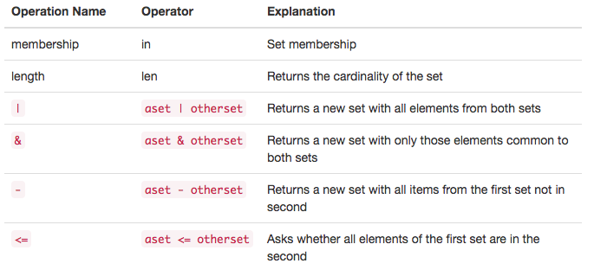
Sets
A set is an unordered collection of zero or more immutable, unique, Python data objects. Sets do not allow duplicates and are written as comma-delimited values enclosed in curly braces.

Slide 14
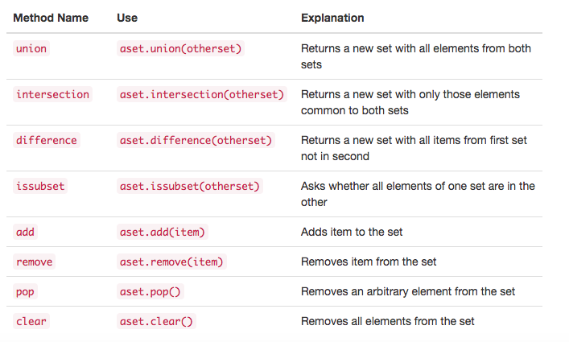
Set Methods

Slide 15
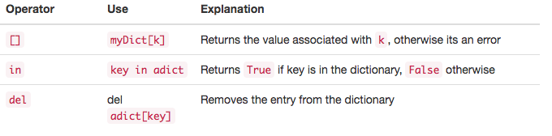
Dictionaries
Dictionaries are unordered collections of associated pairs of items where each pair consists of a key and a value. This key-value pair is typically written as key:value.

Slide 16
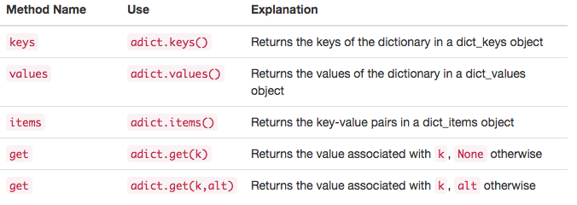
Dictionary Methods
Slide Contents

Slide 17
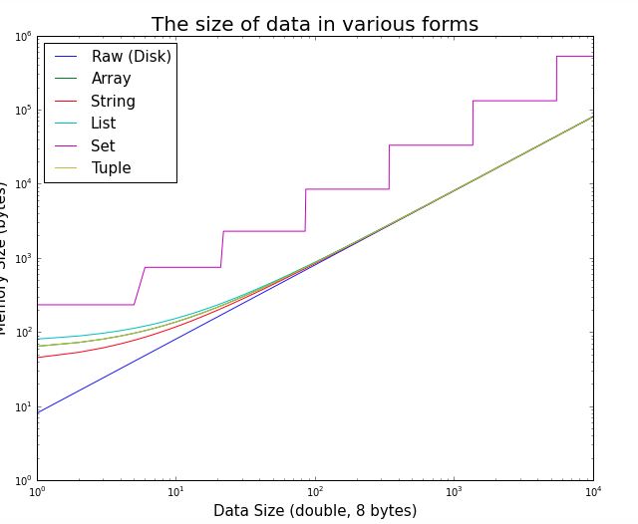
Relative Memory Efficiency
Notes:
Tuples, being immutable, are more memory efficient; lists, for efficiency, overallocate memory in order to allow appends without constant reallocs. So, if you want to iterate through a constant sequence of values in your code (eg for direction in 'up', 'right', 'down', 'left':), tuples are preferred, since such tuples are pre-calculated in compile time. Access speeds should be the same (they are both stored as contiguous arrays in the memory). But, alist.append(item) is much preferred to atuple+= (item,) when you deal with mutable data. Remember, tuples are intended to be treated as records without field names.

Slide 18


